Slide 1
Lecture No. 25 Fuels
At the end of this lecture, students will be able to:
Describe gasoline knocking in IC Engines
Explain the role of octane number and cetane number
Discuss the significance of anti-knocking agents

Slide 2
Knocking
Knocking may be defined as the production of a shock wave in an IC engine as a result of an explosive combustion of fuel-air mixture, leading to a rattling sound
Compression ratio (CR) = V1/V2 = Volume of fuel air mixture at the end of suction stroke / Volume of fuel air mixture at the end of compression stroke
Higher the compression ratio, higher is the efficiency of an IC engine
CR is always greater than one since V₁ being greater than V₂

Slide 3
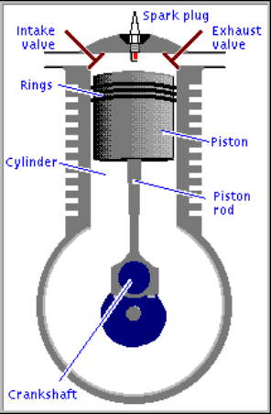
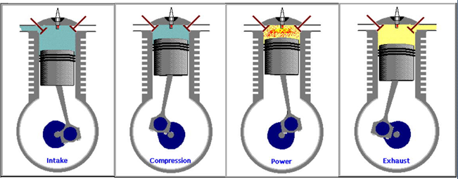
Knocking in petrol engines:
http://www.animatedengines.com/otto.html
Cause for knocking
Working of four stroke petrol engine

Slide 4

Knocking in petrol engines
Mechanism of knocking in chemical terms
Slow oxidation of the fuel (normal condition)
Slow combustion takes place due to the chain reaction

Slide 5
Knocking in petrol engines
Chain reaction continues leading to aldehyde, decomposes to carbon dioxide and water

Slide 6
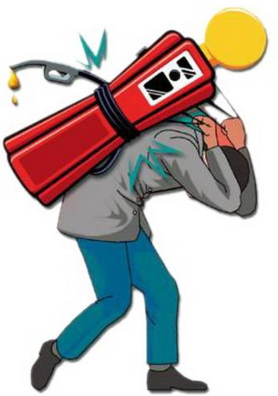
Knocking Effects
Produces undesirable rattling sound
Increases the fuel consumption
Reduces the power output and hence the
efficiency of the engine
Causes mechanical damage due to overheating
to engine parts such as spark plug, piston and engine walls
Unpleasant driving

Slide 7
Knocking Control
High octane gasoline
Low critical compression ratio
Anti-knocking agents such as TEL, TML, etc.
MTBE, ETBE, TMA, Amyl Alcohol

Slide 8
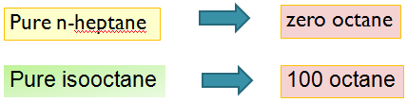
Octane Number
Standard measure of a fuel’s ability to resist knock
Octane number is a measure of the knocking tendency of gasoline fuels in spark ignition engines
Percentage of iso-octane present in a standard mixture of iso-octance and n-heptane which has the same ignition properties as that of the petrol under examination
Octane number of a fuel is determined by measuring its knocking value compared to the knocking of a mixture of n-heptane and isooctane (2,2,4- trimethyl pentane)

Slide 9
Octane Number
Example : If the octane number of a gasoline is 70
It means that it’s knocking characteristics are similar to that of the knocking characteristics of a mixture of 70% isooctane and 30% n-heptane
Order of octane no: Aromatic hydrocarbons > Alkenes > Cycloalkane > Branched chain alkanes > Straight chain alkanes

Slide 10
Cetane number
Quality of diesel oil is measured in terms of its cetane number
Percentage of n-cetane present in a standard mixture of n- cetane and α-methylnaphthalene which has the same ignition properties as that of the diesel under examination
α-methylnaphthalene (C₁₁H₁₀) | n-cetane (n-hexadecane C₁₆H₃₄)
Cetane number=0 | Cetane number=100

Slide 11
Cetane number
Example: If the cetane number of diesel oil is 80 it means that its ignition properties are similar to that of the ignition properties of a mixture of 80% n-cetane and 20% α-methylnaphthalene
Cetane number can be improved by adding ethyl nitrate, acetone peroxide and amyl nitrate which helps in starting ignition
Cetane number of Aromatic hydrocarbons < Alkenes < Cycloalkane < Branched chain alkanes < Straight chain alkanes

Slide 12
Anti knocking
Anti knocking agent:
Anti knocking agent is a chemical substance added to petrol to improve the anti knocking property of the petrol
For example:
Tetra Ethyl Lead (TEL) (phased out)
Tetra Methyl Lead (TML) (phased out)
Methyl Tertiary Butyl Ether (MTBE) (additional oxygen in the ether moiety promotes efficient combustion)
Ethyl Tertiary Butyl Ether (ETBE)
Tetra Methyl Alcohol (TMA)
Disadvantages of leaded gasolines:
Pollutes the atmosphere
Lead poisons the rhodium catalyst which is used in catalytic converters

Slide 13
Summary
Gasoline knocking in IC Engines: production of a shock wave in an IC engine as a result of an explosive combustion of fuel-air mixture, leading to a rattling sound
Role of octane number: Gives information on quality of petrol
Cetane number: : Gives information on quality of diesel
Significance of anti-knocking agents: Improves anti-knocking properties of petrol

